Slide 1
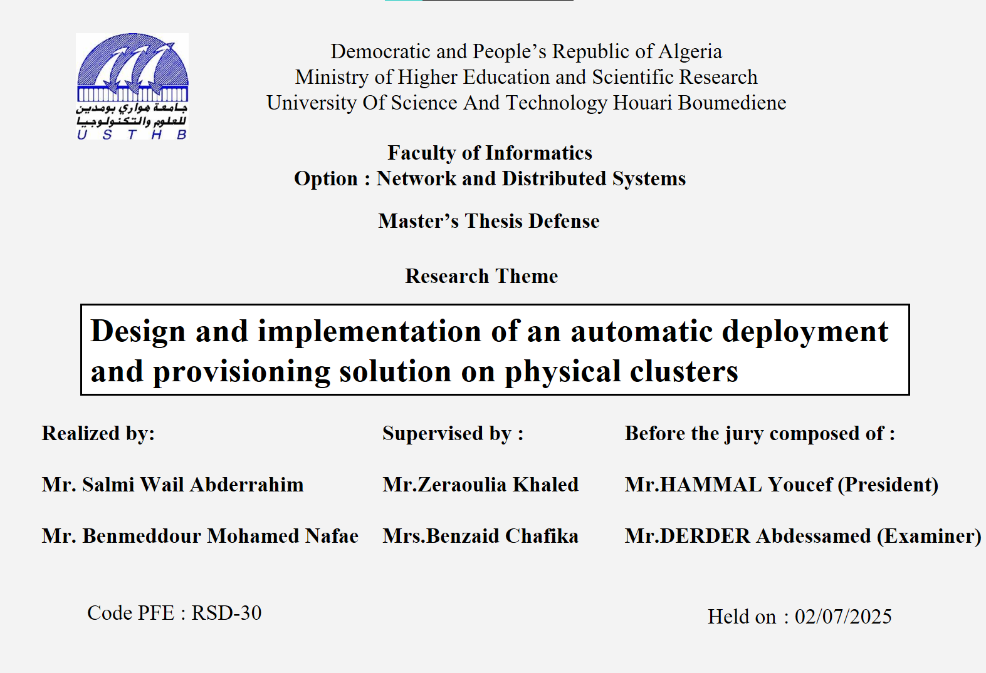

Slide 2
TABLE OF CONTENTS
01
02
04
05
03
Introduction
Challenges / Solutions
Conception
Introduce the context and objectives of the project
Identifies the encountered issues and proposes effective solutions
Details the conceptual design and its layers
06
Implimentation
Evaluation
CONCLUSION
Technologies and practical deployment
Showcasing results from tests
Summarizes the outcomes and outline future improvements

Slide 3
01
Introduction

Slide 4
INTRODUCTION
In today’s digital world, Virtualization has become the backbone of modern IT infrastructure, offering unprecedented scalability and flexibility. Societies such as CERIST and other researcher labs rely on Virtual environments to host everything from simple websites to complex applications. However, this power comes with a significant increase in complexity:
Managing dynamic workloads.
ensuring high availability.
and optimizing resource usage.

Slide 5
Network administrator
DevOps
Help-Desk
A developer might want to "deploy a new web server with three redundant instances." but translating that simple request into reality involves a long sequence of specific tasks and it also necessits different profiles :
provisioning virtual machines and orchestration
configuring networks, setting up load balancers
applying security policies.
This process is not only tedious but also creates a barrier to efficient and agile operations.

Slide 6
02
Challenges and Solutions

Slide 7
Challenge 1 : Building a Robust and Efficient Environment
The Problem: Resource Waste vs. Operational Complexity
Traditional Virtual Machines (VMs) are heavyweight and inefficient. They consume significant overhead, leading to wasted resources.
While containers solve this efficiency problem, managing them at scale introduces immense complexity.
How do we build a foundation that is both resource-efficient and automatically resilient to failure?
Our Solution: A Clustered, Hybrid Foundation
We designed an optimal architecture that combines the efficiency of containers with the stability of a virtualized environment.
This hybrid model dramatically increases resource utilization while leveraging mature enterprise features like high-availability clustering and distributed storage to ensure no single point of failure.

Slide 8
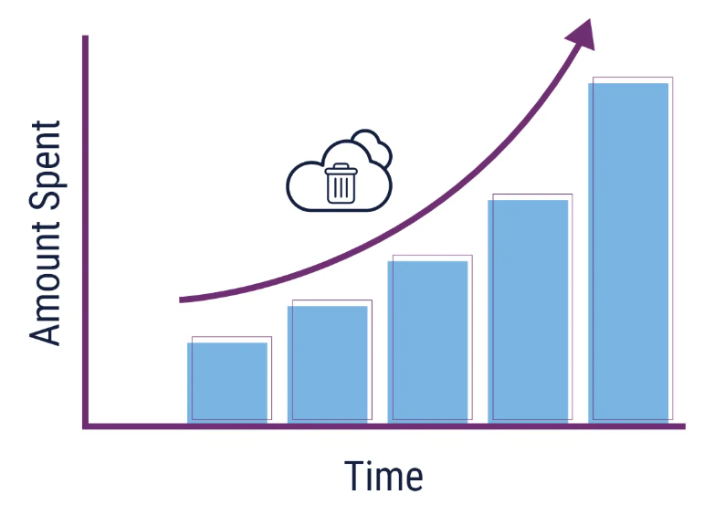
Challenge 2 : The Growth Challenge: Scaling Without Chaos
The Problem: Manual management is unsustainable and time-consuming
As a platform grows, the number of virtual machines and services explodes. Managing this scale manually is a logistical nightmare.
How can we manage and grow our infrastructure rapidly and reliably, without drowning in manual work?
Our Solution: An Automated, Software-Defined Lifecycle
We treat our entire infrastructure as code.
This strategy enables end-to-end automated provisioning and scaling, transforming massive deployment tasks from weeks of manual labor into a fast, reliable, and repeatable process.

Slide 9
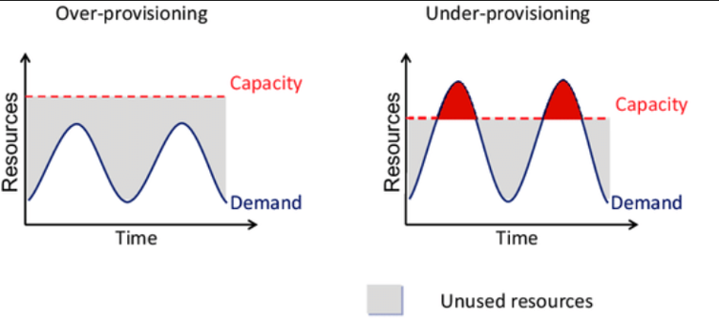
Challenge 3 : The Optimization Challenge
The Problem: Guesswork Leads to Waste and Instability
Even with full automation, an expert operator must still write complex code and critically guess the right amount of resources for a new service.
How can we eliminate resource waste and performance risk from the deployment process?
Our Solution: An Intelligent Agent for Smart Provisioning
We introduce an intelligent agent that acts as an expert co-pilot.
It is designed to understand natural language commands, analyze the system's real-time needs, and automatically generate the optimal configuration, eliminating the dangerous guesswork that leads to waste and poor performance.

Slide 10
03
Conception

Slide 11
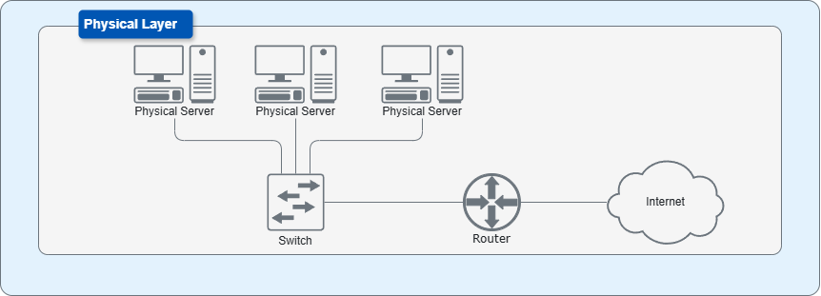
The Infrastructure backbone
Physical Layer:

Slide 12
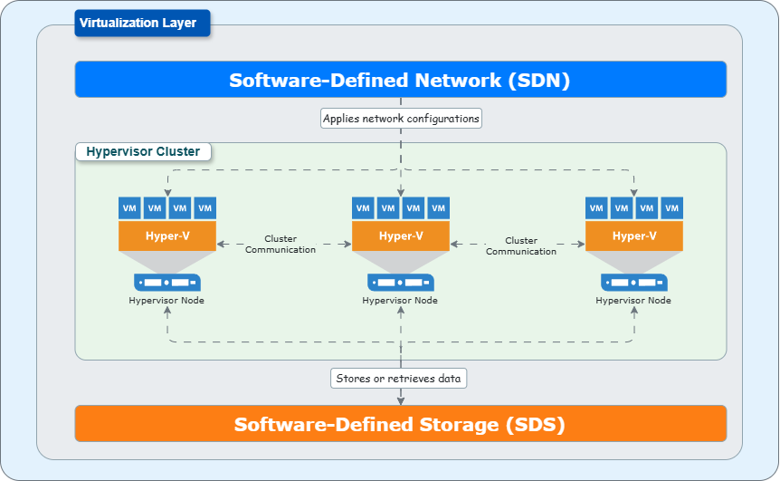
Virtualization Layer:

Slide 13
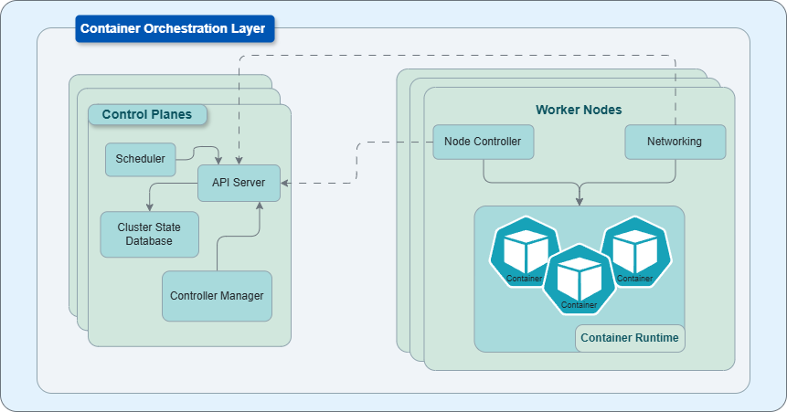
Orchestration Layer:

Slide 14
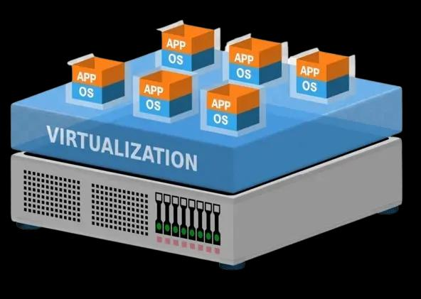
Orchestration Layer:
Orchestration
deploy
Virtualization
Run on top
Hard-ware

Slide 15
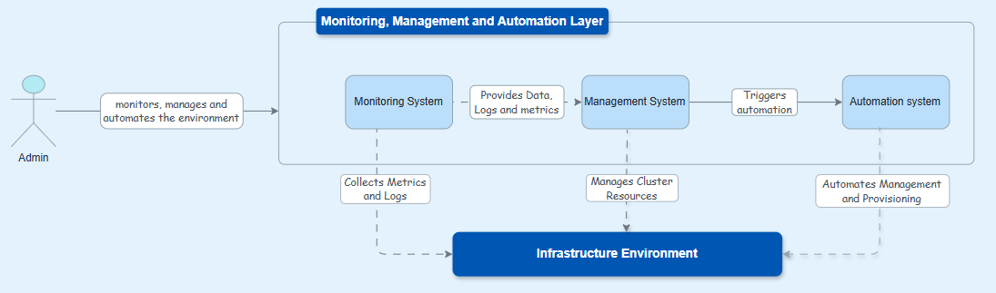
The Infrastructure Control Room
This layer is the central control room for our infrastructure, supporting both direct human intervention and a policy-driven feedback loop.
Monitoring acts as the eyes and ears, collecting data from the environment.
Management is the brain, analyzing this data and deciding when to act.
Automation serves as the hands, executing the required tasks automatically.

Slide 16
Infrastructure Intelligent Expert Assistant
This layer is the core innovation of our project. It acts as the intelligent expert assistant for the administrator, automating the most complex part of infrastructure management.
It understands high-level, natural language commands, not complex code.
It analyzes the real-time state of the infrastructure to make smart decisions.
It reasons about the optimal solution to prevent waste and ensure performance.
Finally, it generates the perfect configuration, bridging the gap between human intent and machine execution.

Slide 17
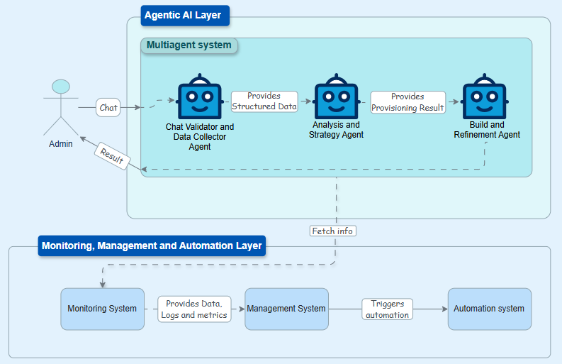
Agentic AI Workflow:

Slide 18
04
Implimentation

Slide 19
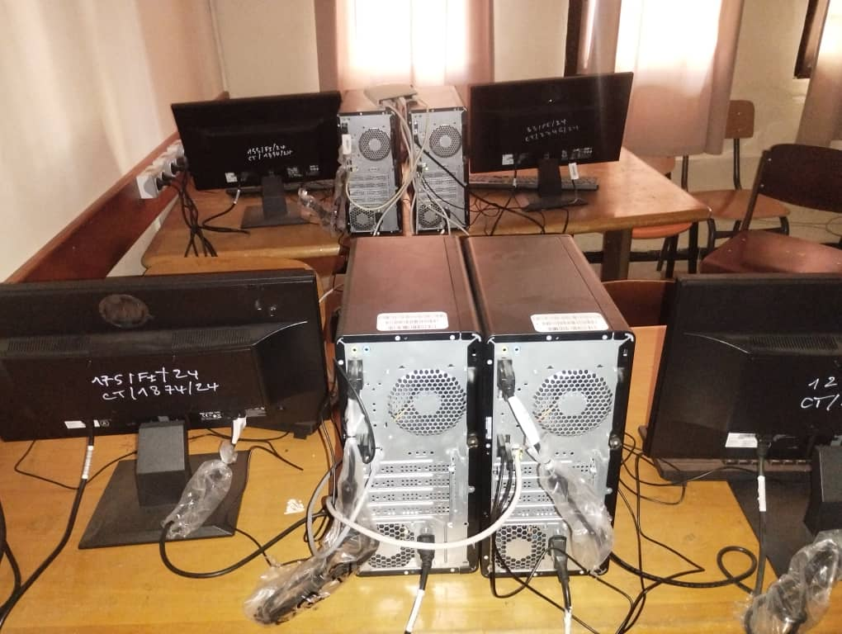
HARD-WARE
4 physical homogenize machines
1 switch connects all 4 machines together and to the Internet.
CPU: 12th Gen Intel Core i7-12700 (1 Socket, 12 Cores, 20 Threads)
RAM: 32 GB
Storage: 1 TB NVMe SSD
Network Interface: 1x 1GbE Network Interface Card (NIC)

Slide 20
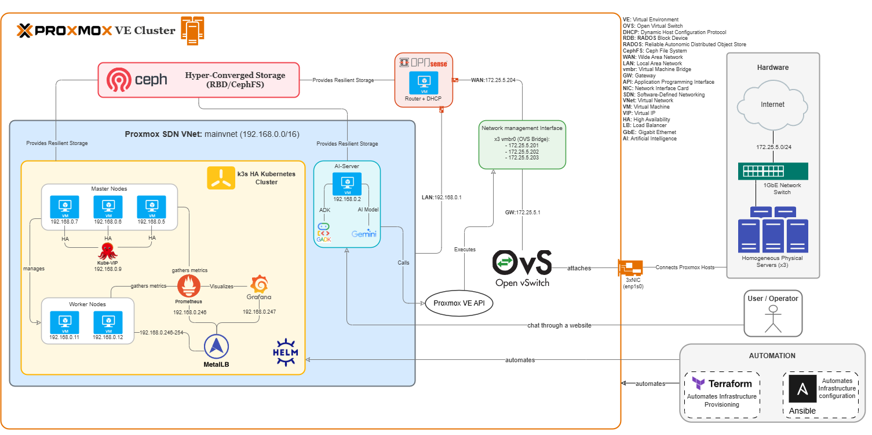

Slide 21
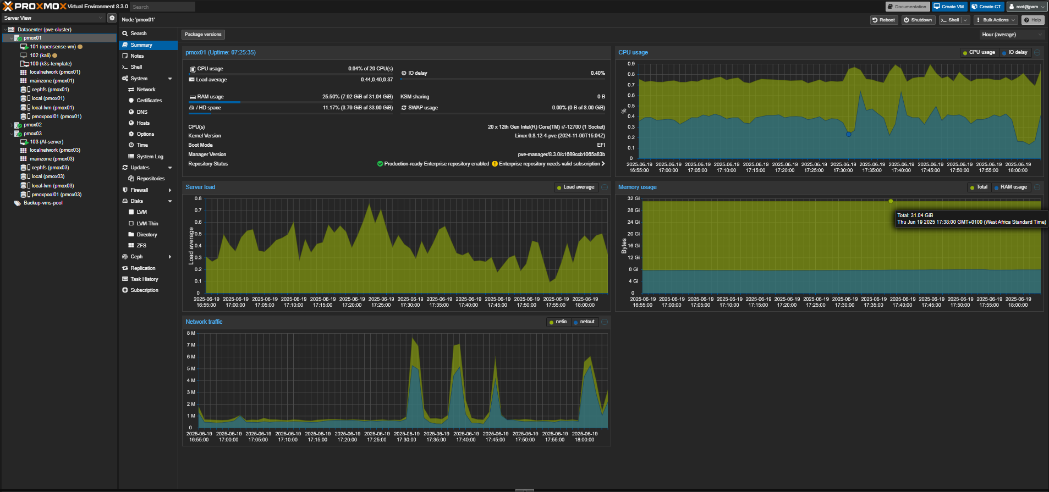
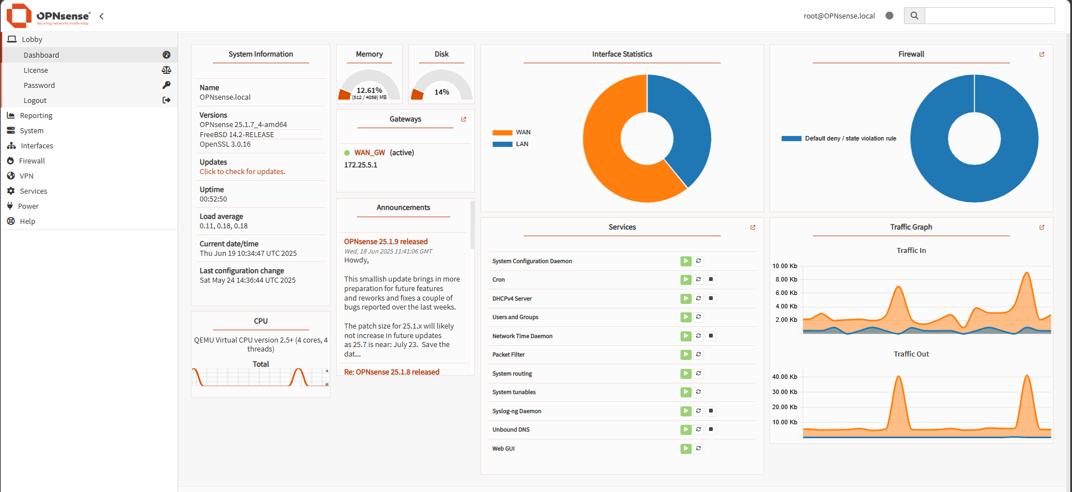
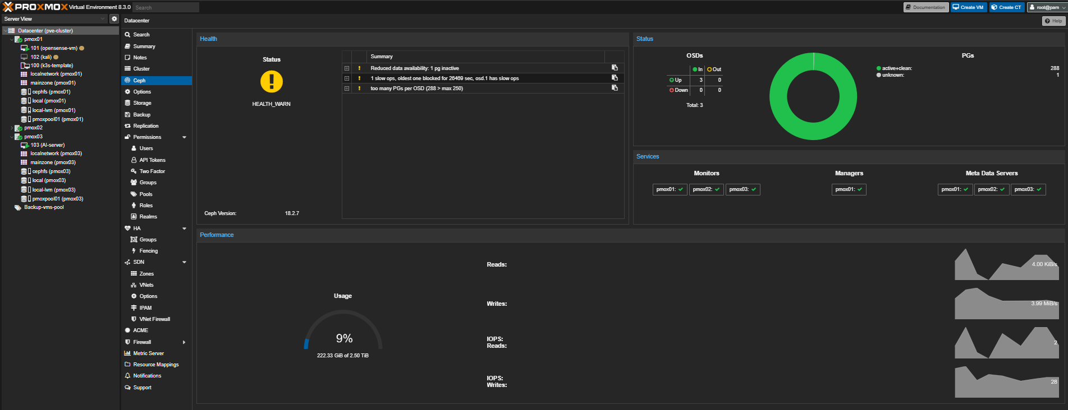
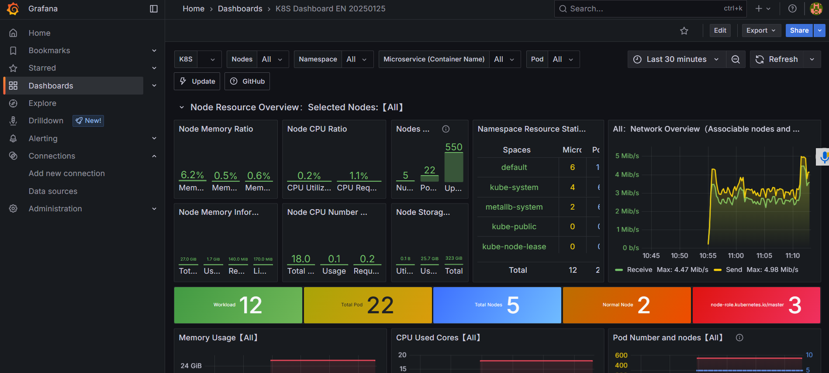
The Result: A Unified and Observable Platform

Slide 22
05
Evaluation

Slide 23
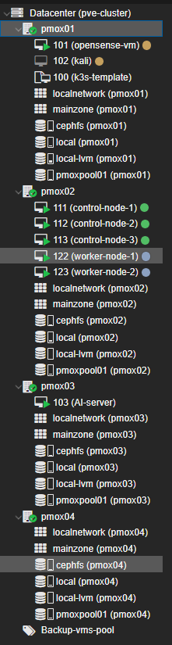
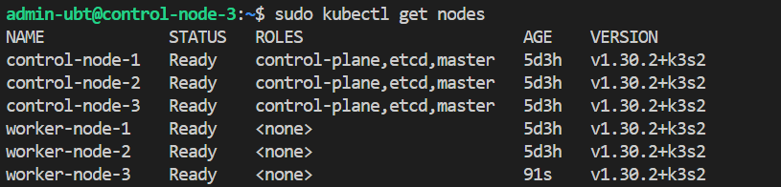
Scenario 1: Automation-Driven Scalability
This scenario tested the system's ability to grow. We started by adding a new physical server to the Proxmox cluster, then used our automated Terraform and Ansible workflow to seamlessly provision and configure a new Kubernetes worker node on it. The test validated that our Infrastructure as Code (IaC) approach makes scaling a fast, repeatable, and reliable process.

Slide 24
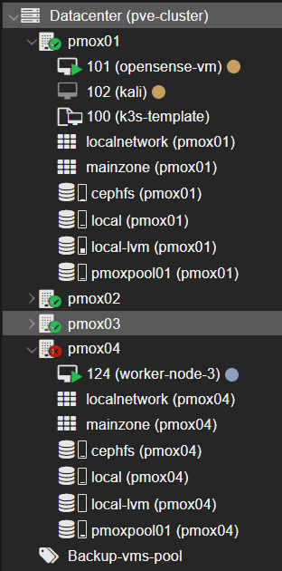
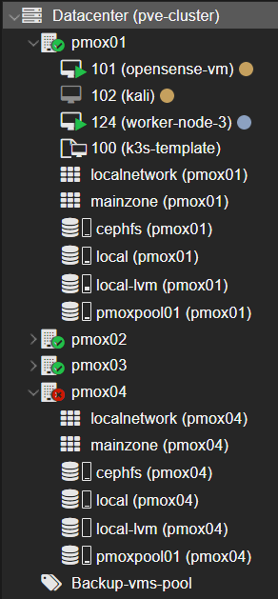
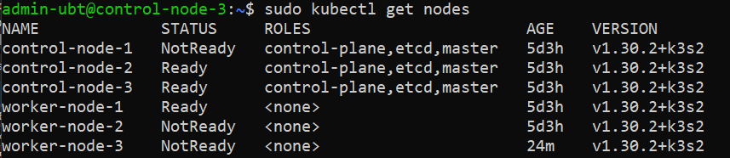
Scenario 2: Multi-Layered Fault Tolerance
This scenario simulated real-world disasters. First, we abruptly powered off a physical Proxmox host. Second, we shut down a critical Kubernetes control-plane node. In both cases, the system's high-availability mechanisms automatically took over—Proxmox HA migrated the VM, and the k3s cluster remained fully operational—proving the platform's robust, multi-layered resilience.

Slide 25
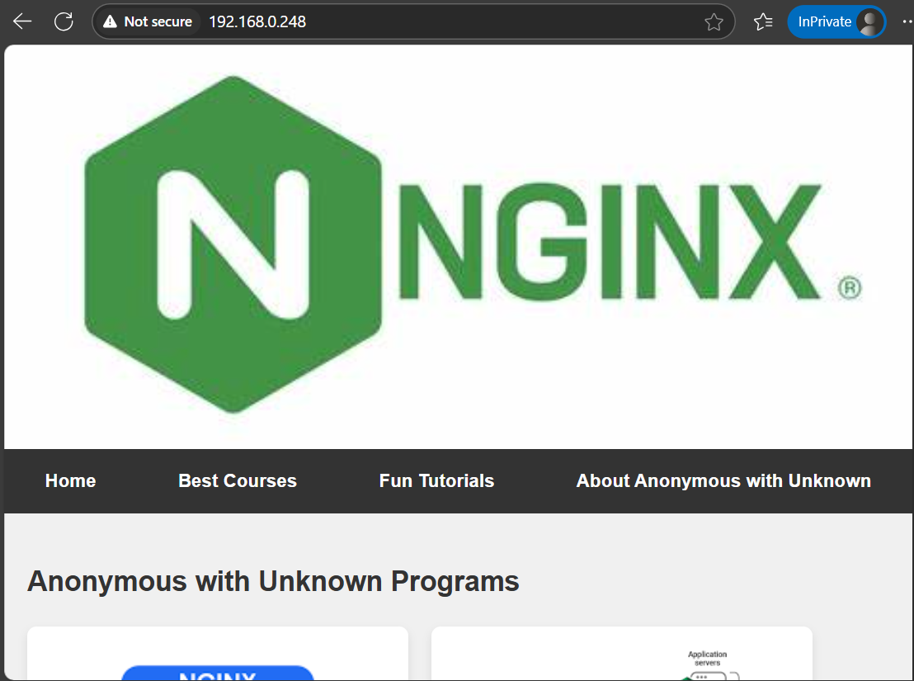
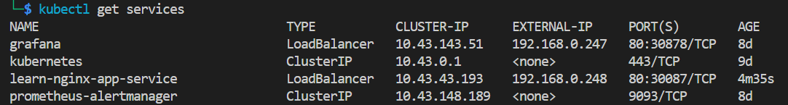
Scenario 3: End-to-End Application Deployment
This scenario demonstrated the platform's practical utility. We deployed a standard web application using a Kubernetes manifest. The system correctly scheduled the application pods, and the software-defined network (using MetalLB) automatically assigned an external IP, making the service accessible. This test confirmed that all layers work together to successfully run and expose applications.

Slide 26
Scenario 4: Intelligent Provisioning with the Agentic AI Layer
This scenario validated the platform's core innovation: intelligent automation. We provided a high-level, natural language command to the system. The Agentic AI correctly interpreted our intent, analyzed the cluster's state, and automatically generated a complete and optimized Terraform configuration file for the smart provisioning of a VM into Proxmox. This test confirmed the AI's ability to bridge the complex gap between simple human requests and low-level infrastructure execution, preventing costly over- and under-provisioning.

Slide 27
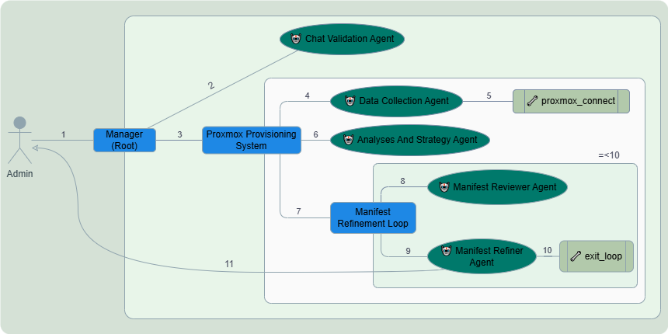
architecture of the Smart Provisioning System:

Slide 28
result
Choice justification

Slide 29
06
CONCLUSION
Conclusion & perspective

Slide 30
Conclusion :
An intelligent and modular architecture was developed to automate resource provisioning in virtualized private cloud environments initiating the foundation for the next generation of cloud infrastructures. The design integrates virtualization, orchestration, monitoring, automation, and an AI-driven multi-agent layer capable of translating natural language input into executable infrastructure operations. The system demonstrated strong adaptability, reduced manual complexity, while ensuring optimal resource utilization, preventing the critical problems of over and under provisioning.

Slide 31


Perspectives :
Introduce Security considerations, including secure API communication, and encrypted inter-agent communication.
Enhance generative AI involvement in demand forecasting, synthetic workload generation, and adaptive scaling strategies.
Extend architectural compatibility with hybrid and multi-cloud environments, such as AWS, to support elasticity and regulatory compliance.
Investigate autonomous agent learning mechanisms for real-time behavioral adaptation and long-term infrastructure optimization.

Slide 32
THANKS! For Paying Attention

